Slide 1

ECE 530 Cloud Computing
Ioannis Papapanagiotou
Data Pipeline with Messaging System

Slide 2
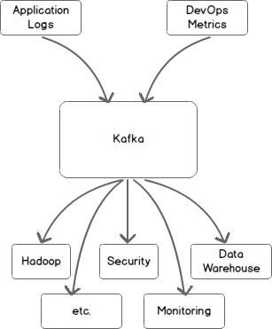
Data Pipeline - with Messaging System
Let’s look at this picture again, using a messaging system (Kafka) as a central messaging bus.
All incoming data is first placed in Kafka and all outgoing data is read from Kafka.
Kafka centralizes communication between producers of data and consumers of that data.

Slide 3
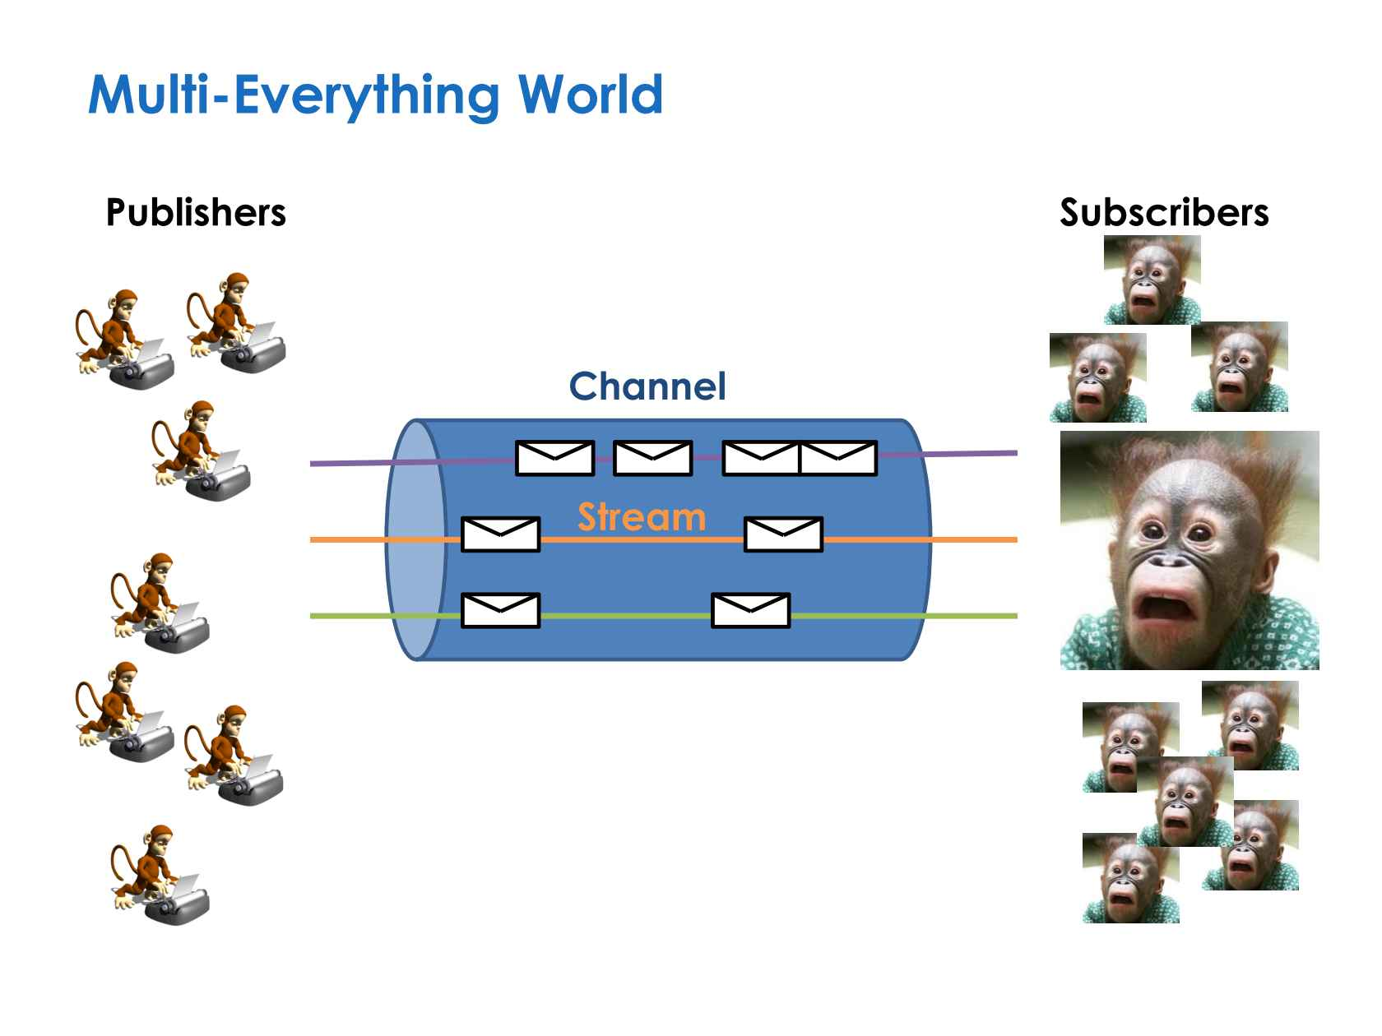
Pub-Sub model

Slide 4
Messaging
Messaging consist of:
Producer are the ones that generates messages.
Consumer are the ones that consumes messages generated by the producer.
Between the producer and consumer there is a message broker that is used to synchronize the messages between them.
The Message Broker performs the synchronization of messages with the help of queues which are used to add new messages or remove messages which are consumed.

Slide 5
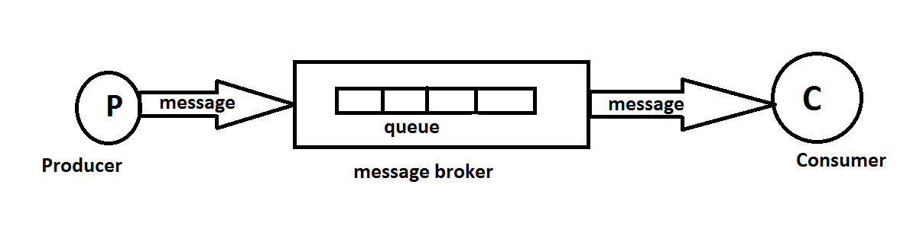
Messaging
Store and forward: The broker implements the store and forward mechanism to synchronize messages.
The queue in the broker will store the messages until and unless some consumer consumes those messages.
The consumer consumes the message, processes it and sends an acknowledgement to the message broker to indicate the successful delivery of the message.

Slide 6
Decoupling
The producers and consumers are separated from each other and they involve decoupling to exchange messages with each other. There are 3 types of decoupling:
Logical decoupling: The producers and consumers do not know anything about each other except the routing information.
Physical decoupling: The producers and consumers are on the completely different locations.
Temporal decoupling: The messages are consumed by the consumer at a later stage.

Slide 7
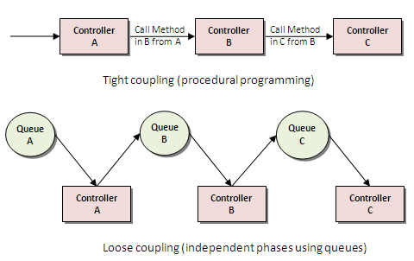
Queues and Loosely Coupling

